Slide 1
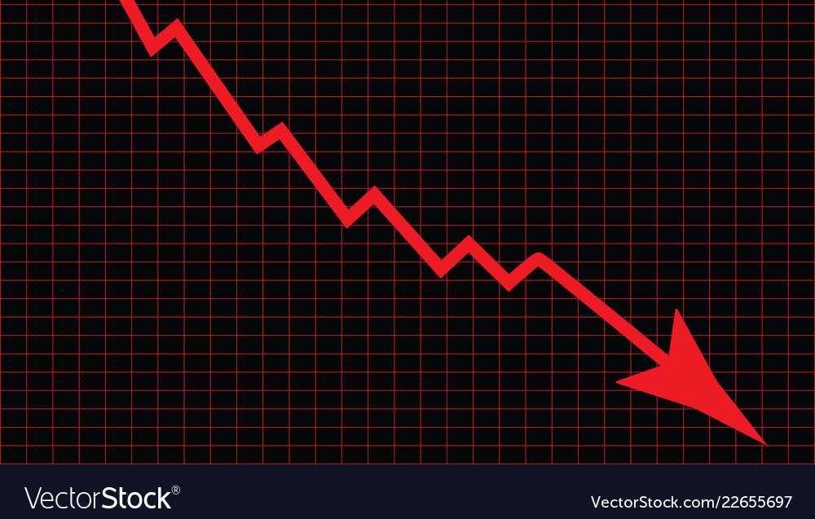
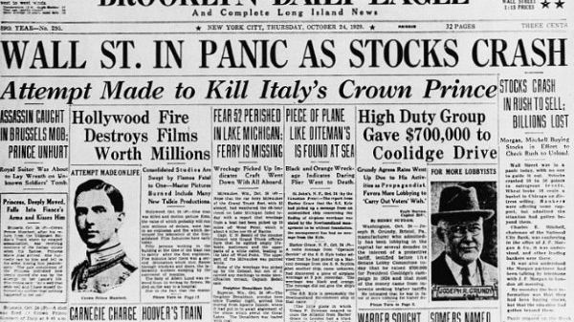
Market crash KEY indicators & optimal portfolios
Is your portfolio ready
for a crash?
Andre Montgomery,
Nicholas Pamboukis

Slide 2
Core Message
Stock Market Opportunities During Bear Market
Examining Different Sectors that Make up the S&P500
Look at Outside Influences (ie. Economic Status of Unemployment, GDP, Federal Fund Rate and Inflation)

Slide 3
Questions & Data
Three Main Stock Market Crashes:
Dotcom Bubble: Real Estate Crisis: COVID
Which sectors of the S&P 500 performed well?
With the current economic environment: should we brace ourselves for another crash? If so, where can I “safely” put my money?

Slide 4

The Dotcom Bubble of the early 2000’s

Slide 5
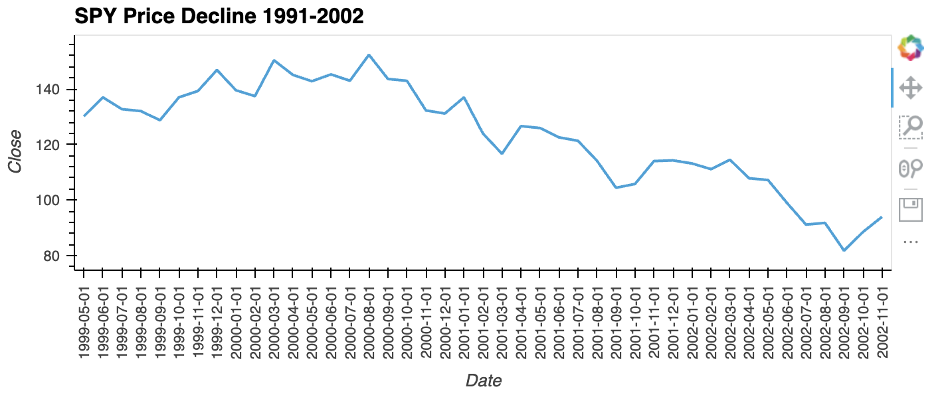
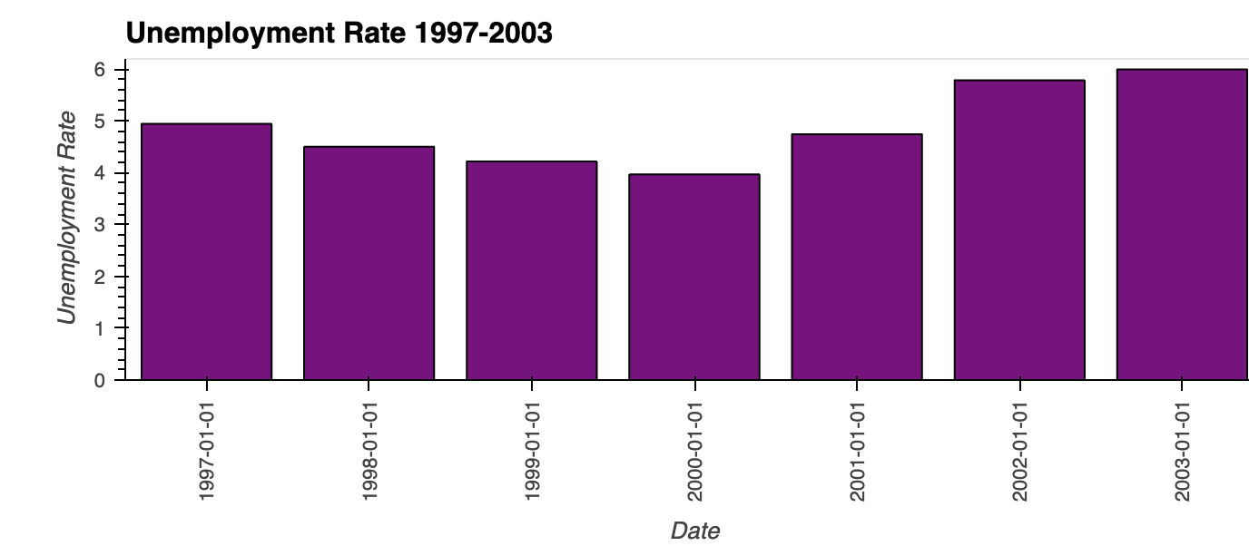
The Market fell 78% from its peak 2000-2002

Slide 6
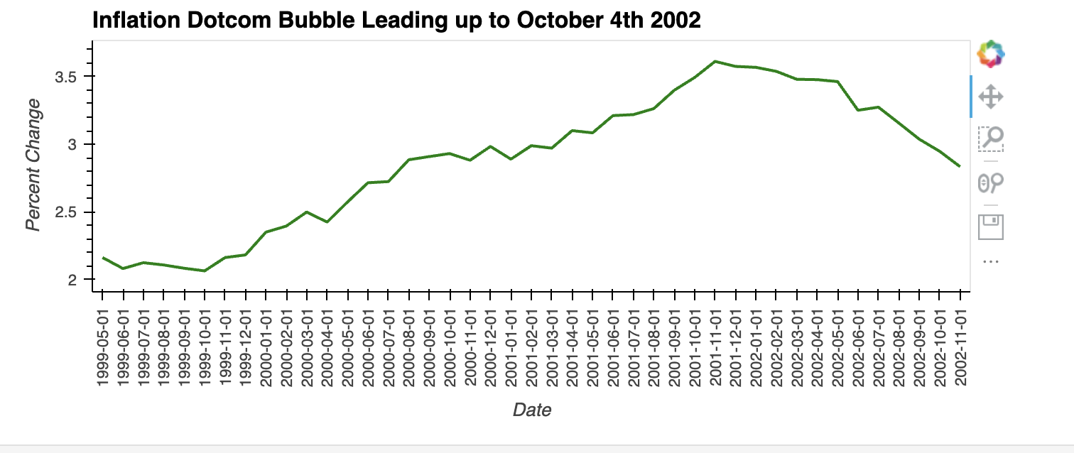

Slide 7
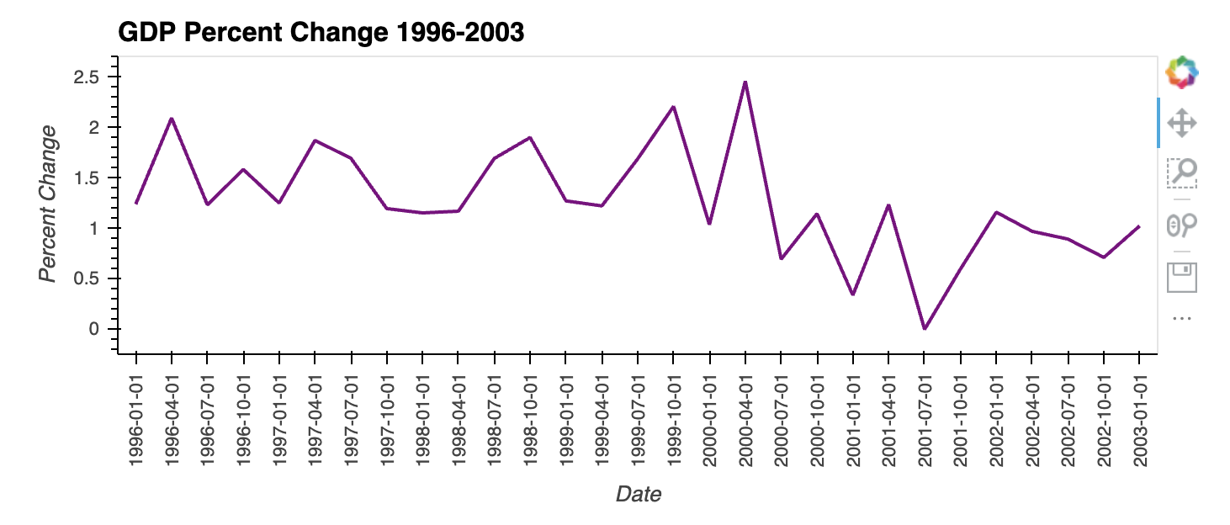

Slide 8
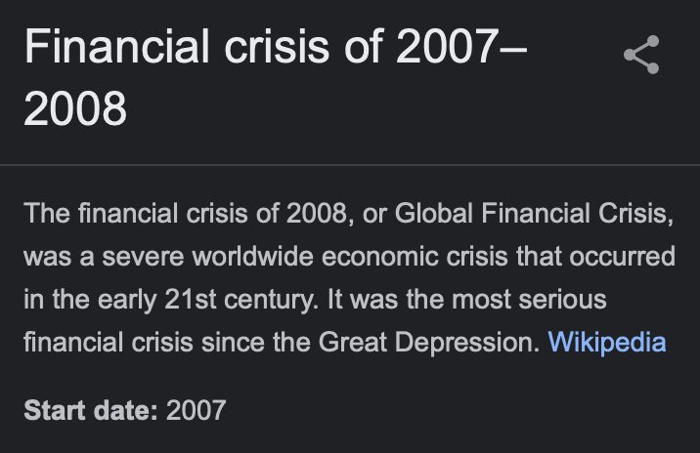
”Housing” Market Crash
- October 7, 2007 – March 28, 2013
- Mortgage Backed Securities

Slide 9
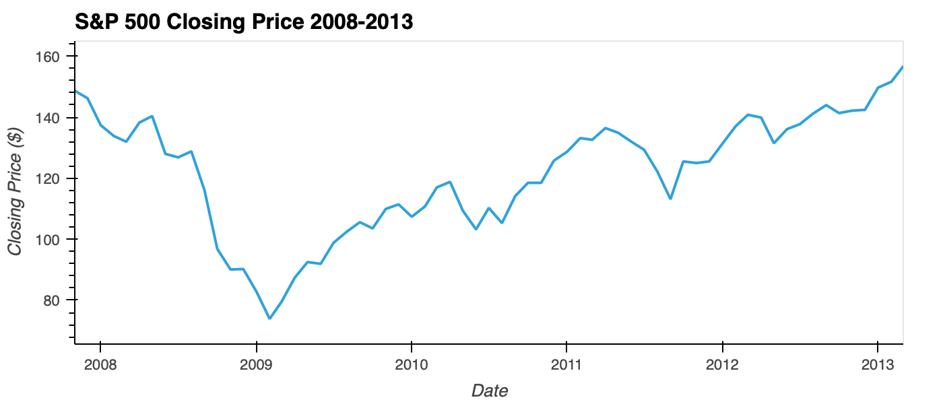

Slide 10
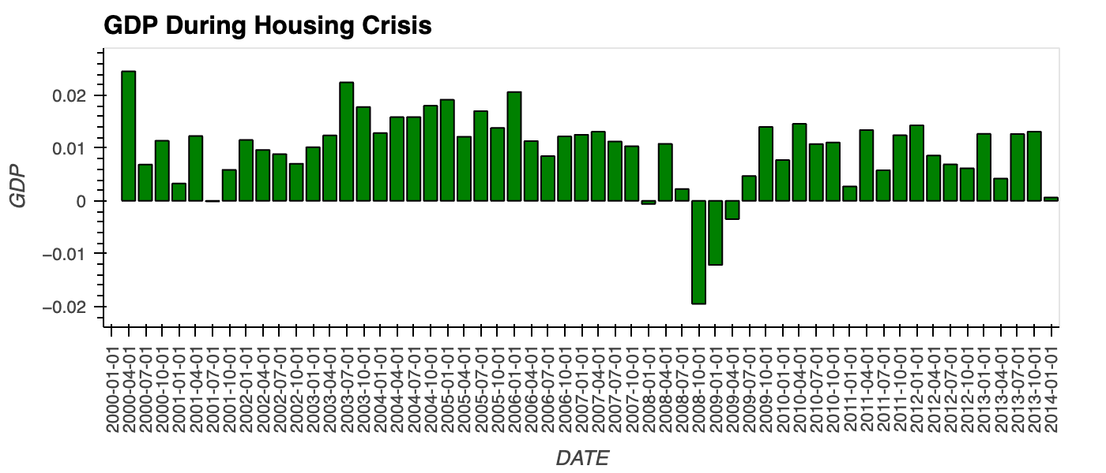


Slide 11
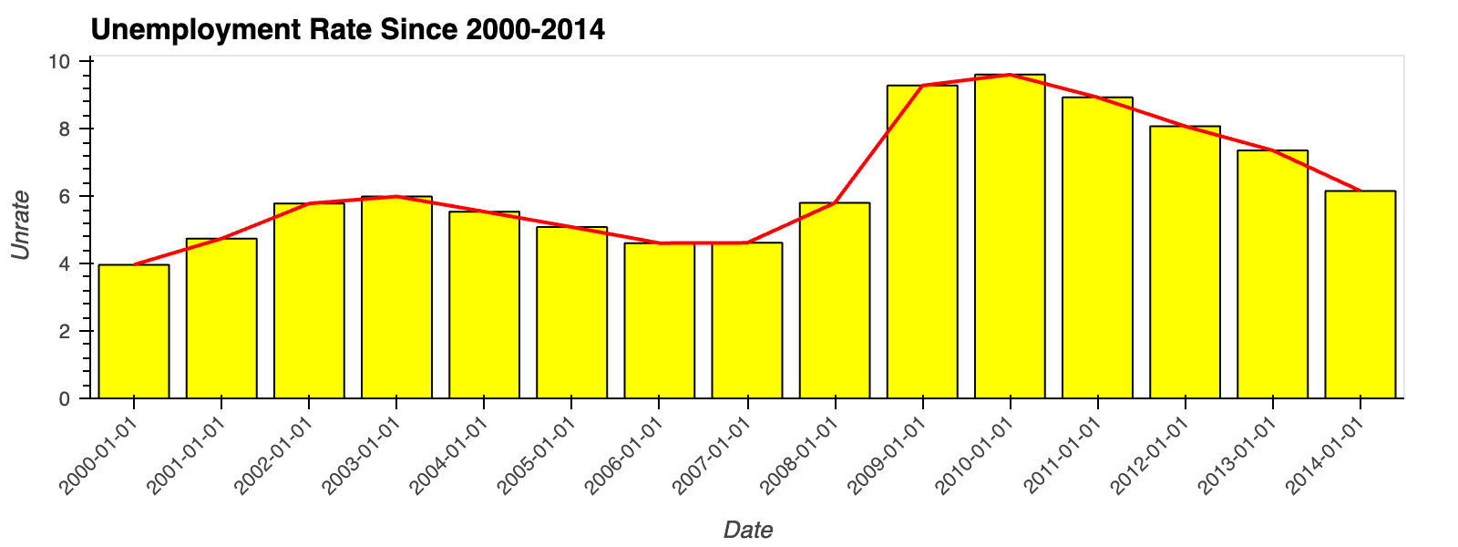

Slide 12
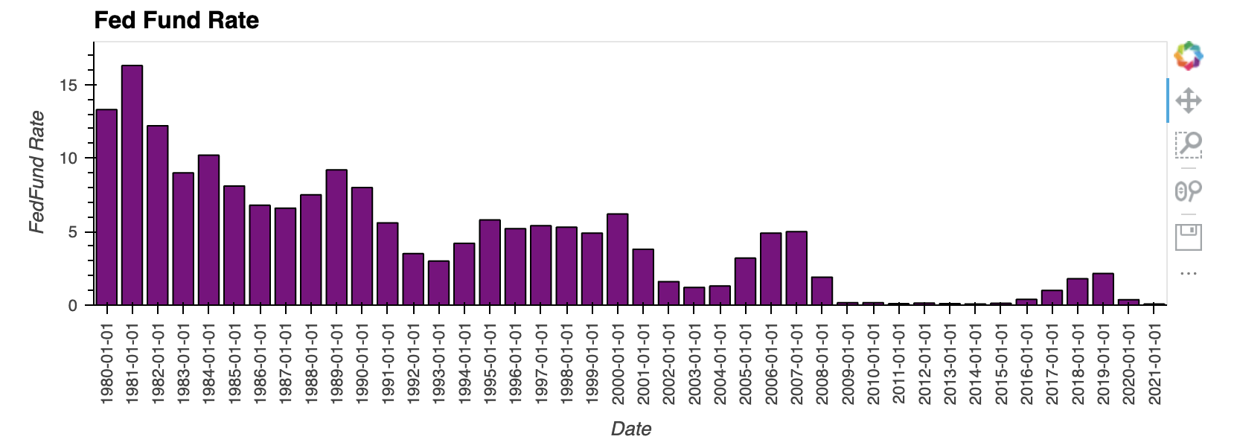

Fed-fund rate

Slide 13
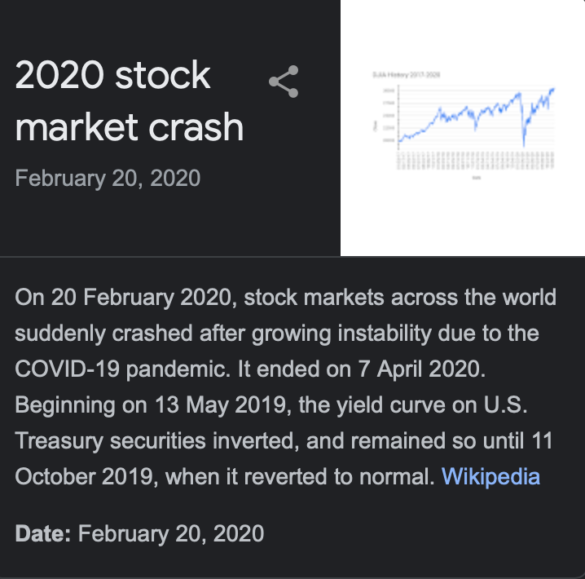
COVID Crash
February 20, 2020 – April 7, 2020
Economy: Artificial Coma
Indicators

Slide 14
Ten Sectors
Communication Service
Information Technology
Consumer Discretionary
Consumer Staples
Energy
Financials
Health Care
Materials
Real Estate
Utilities

Slide 15
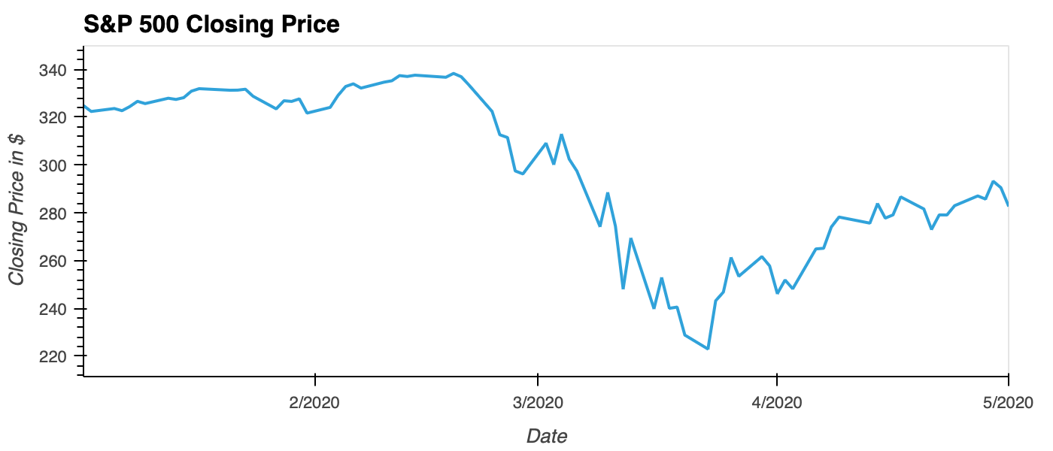
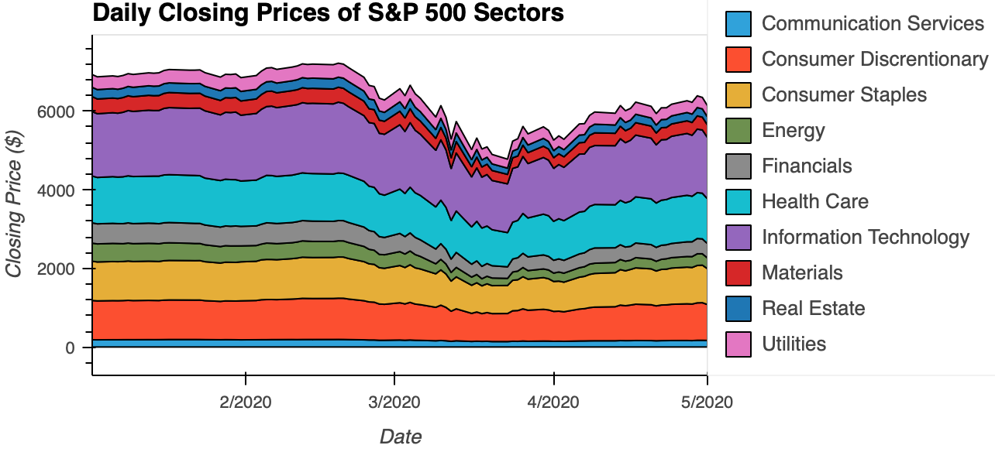

Slide 16
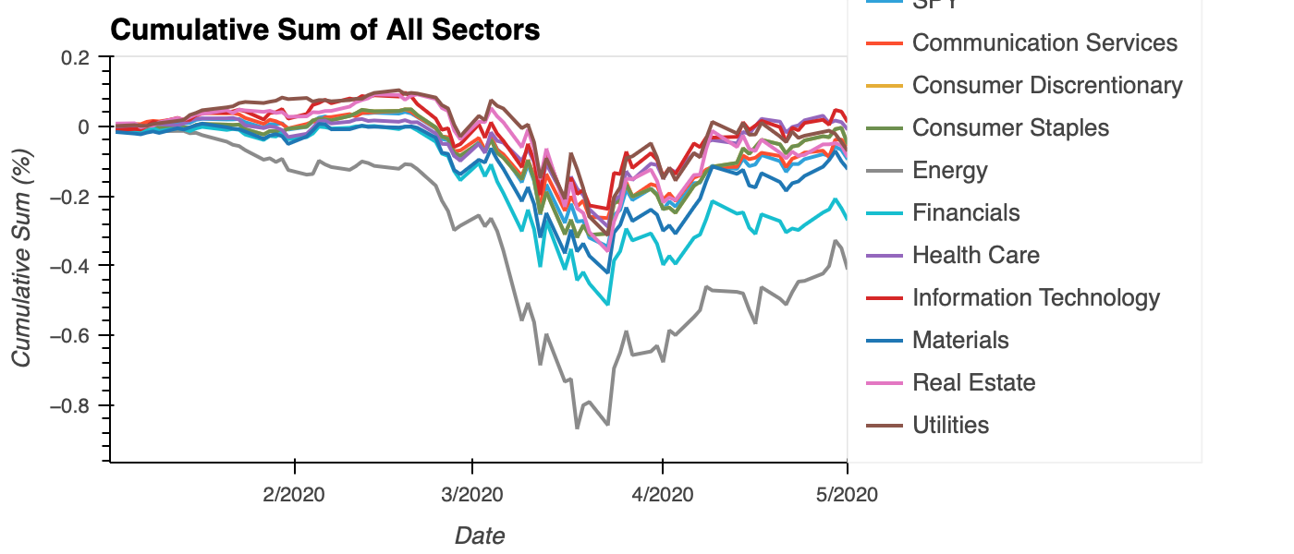

Slide 17
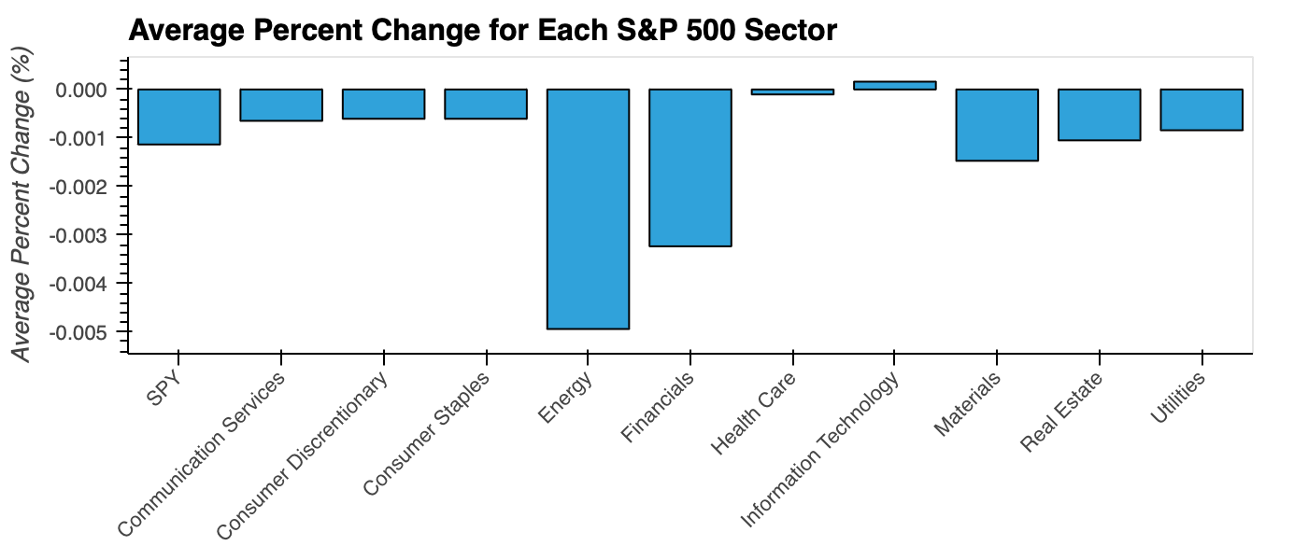
S&P500 Sectors
Average Percent Change
Volatility
Information Technology vs Health Care

Slide 18
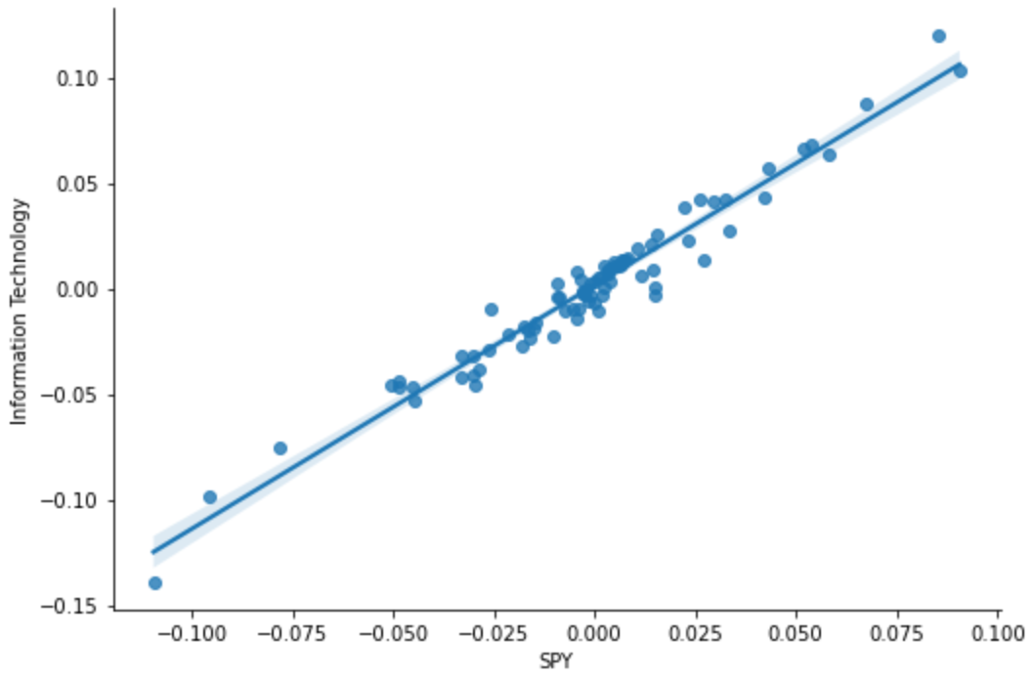
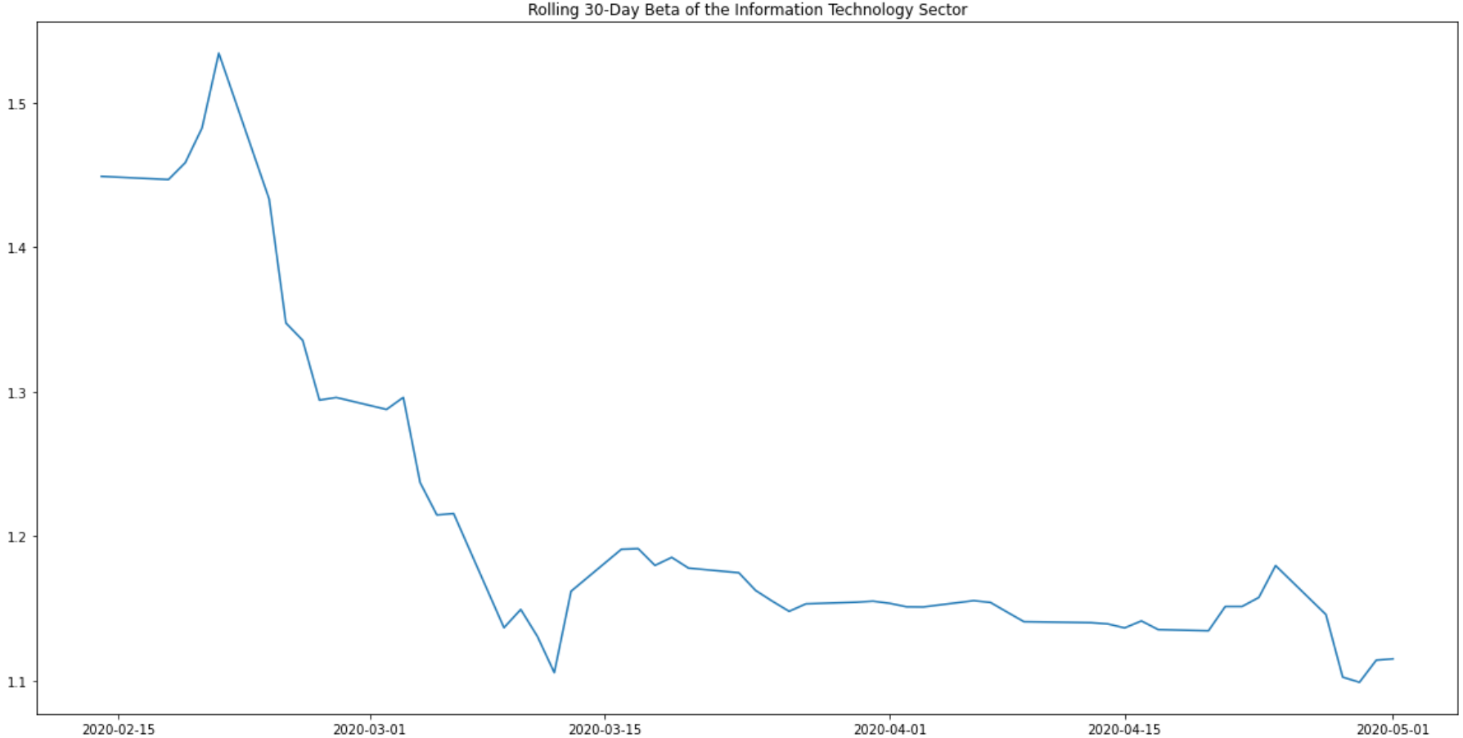
Information Technology
cov = 0.001241
σ2 = 0.001075
β = 1.155

Slide 19
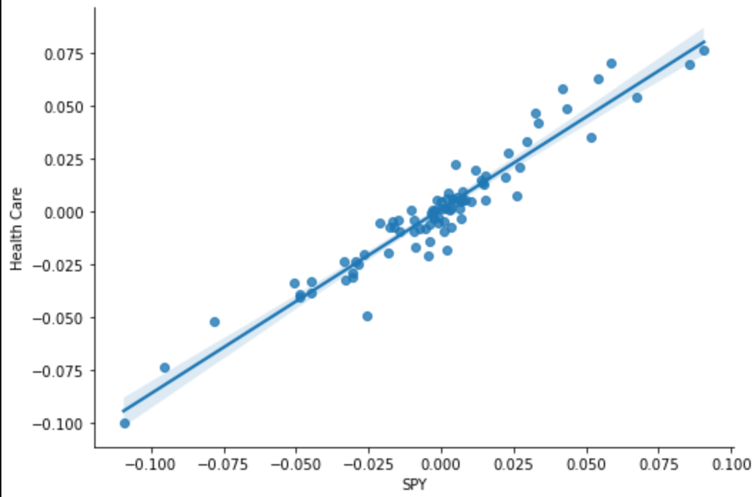
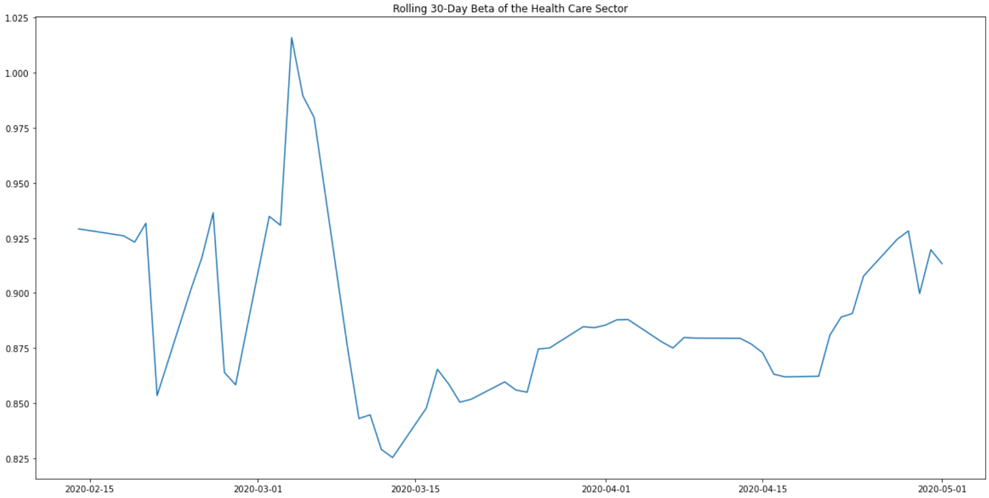
Health Care
cov = 0.0009377
σ2 = 0.0010747
β = 0.873

Slide 20

Are we headed for a crash????

Slide 21
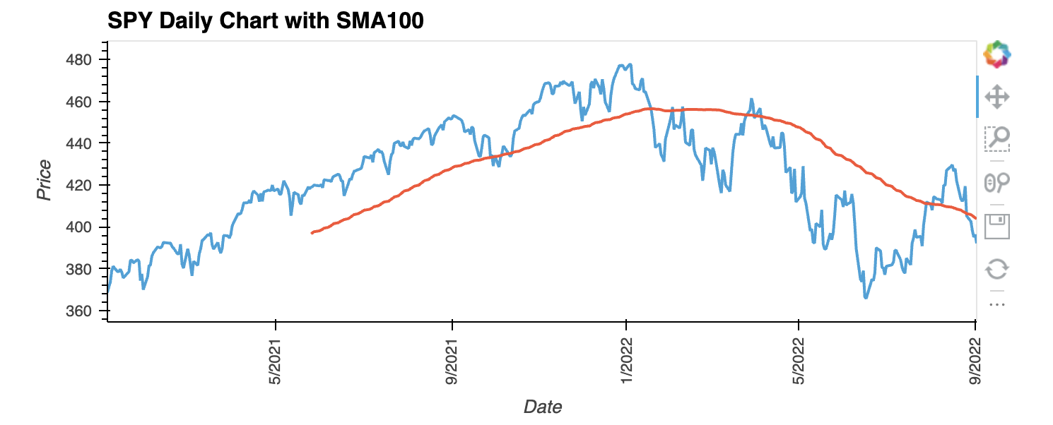
SPY 2021-Present & SMA100 – 23.4% drop from the high

Slide 22
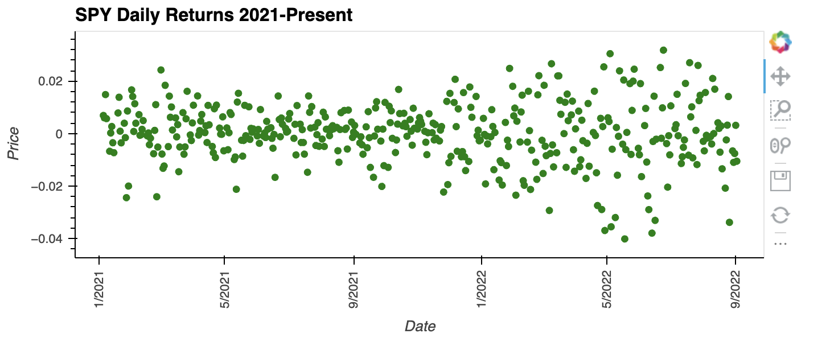
SPY Daily Returns 2021-Present

Slide 23
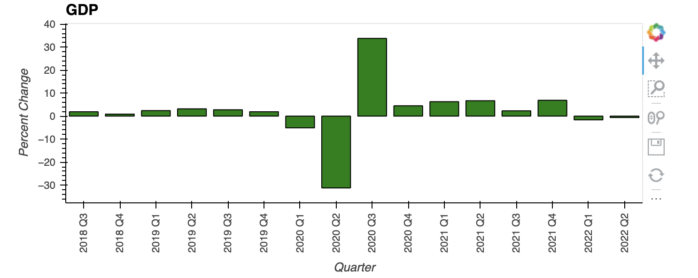
GDP 2018-Present

Slide 24
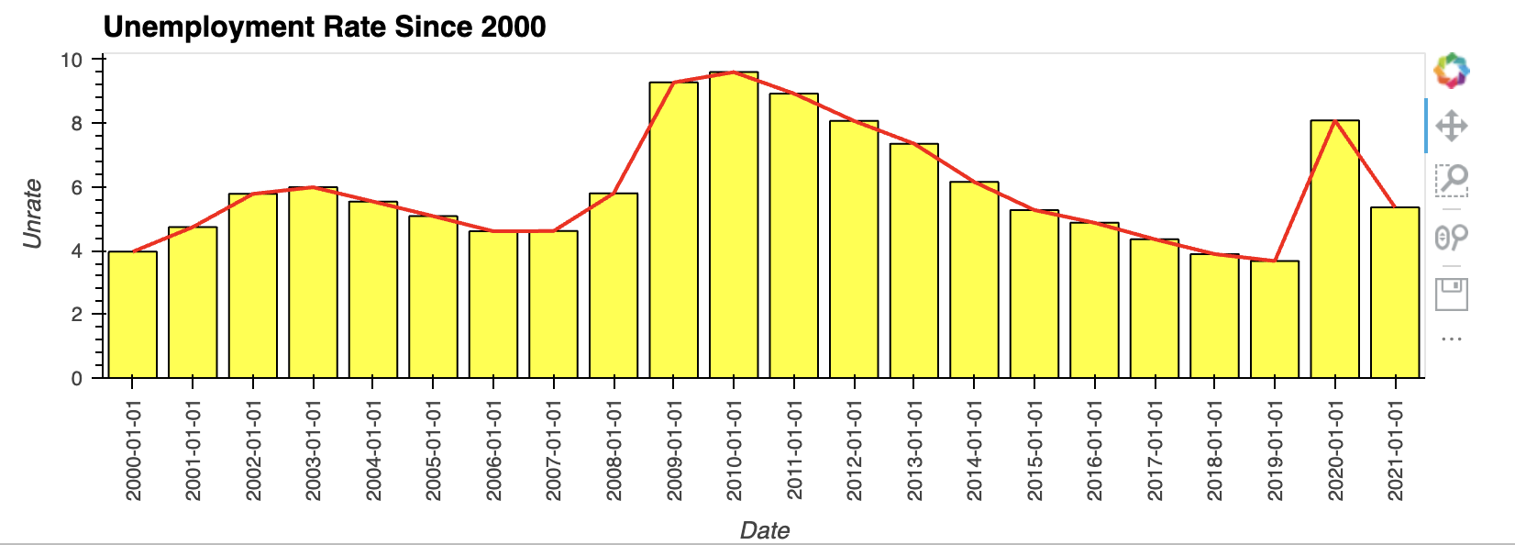
Unemployment 1996-present

Slide 25
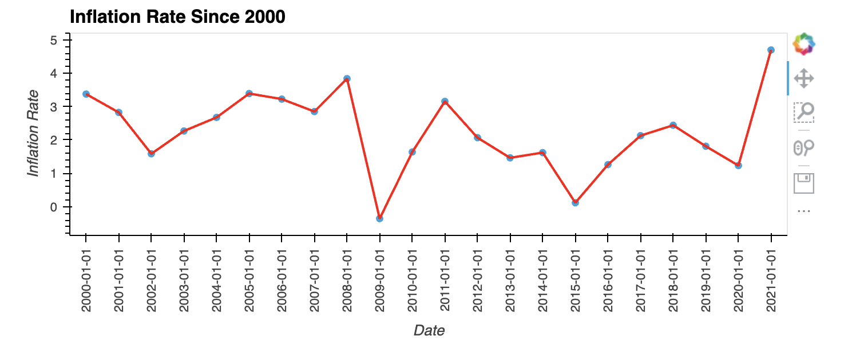
Inflation rate

Slide 26
Fed-fund rate

Slide 27
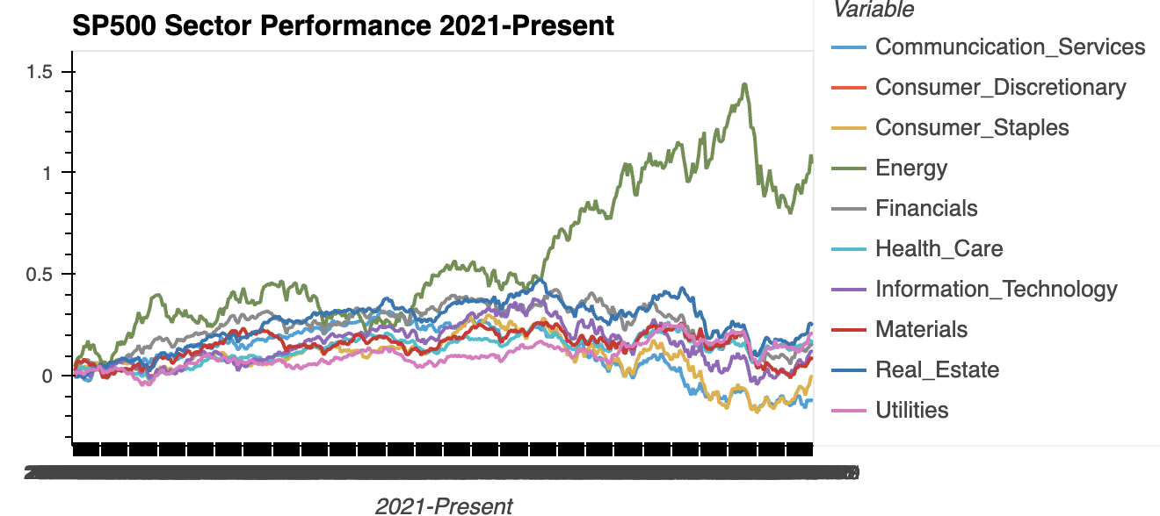

Slide 28
Top Performing Sectors Since 2021 Bear Run
Communication Services: -12.28
Consumer Discretionary: 0.02
Consumer Staples: 0.02
Energy: 104.42
Financials: 14.73
Health Care: 16.23
Information Technology: 11.88
Materials: 8.04
Real Estate: 24.78
Utilities percent: 21.0

Slide 29
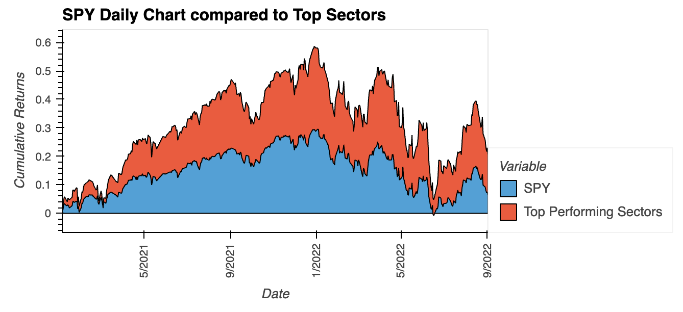
Top sectors vs s&p

Slide 30
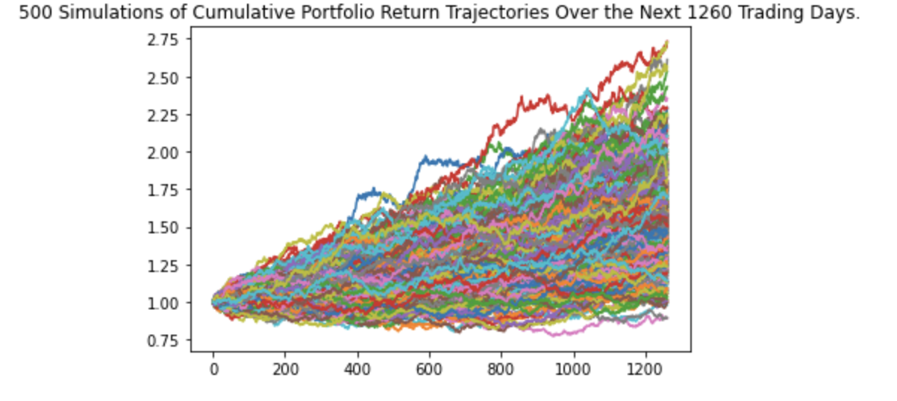
There is a 95% chance that an initial investment of $10,000 in the portfolio over the next 5 years will end within in the range of $10462.85 and $22272.81

Slide 31
Q&A

